Slide 1
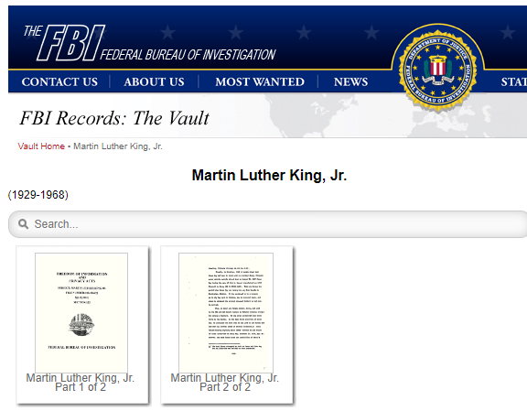
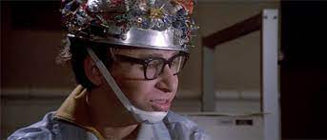
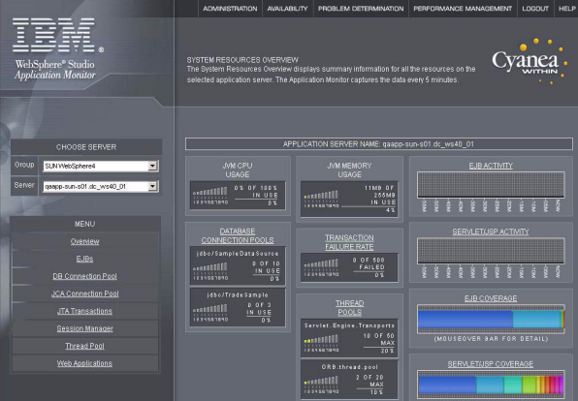
FBI
PENDING: FEDERAL BANK.nonPolieQOS
Tivoli
Identity Manger
W/SAM
Cosco laura
Pink pants
Densie 14 vagina
And pubic hair
AND prostion Seattle
starbucks
FBI Vault
JFK
MLK
Ghostbusters
[x] no

Slide 2
FBI
PENDING: FEDERAL BANK.nonPolieQOS

Slide 3
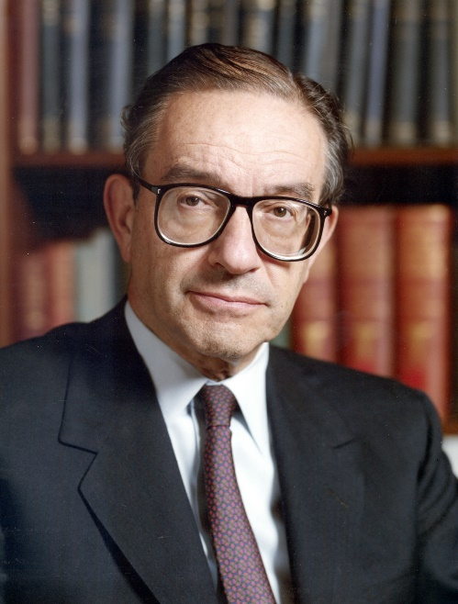
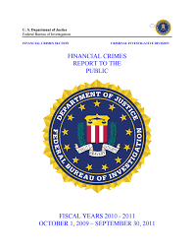
FBI

Slide 4
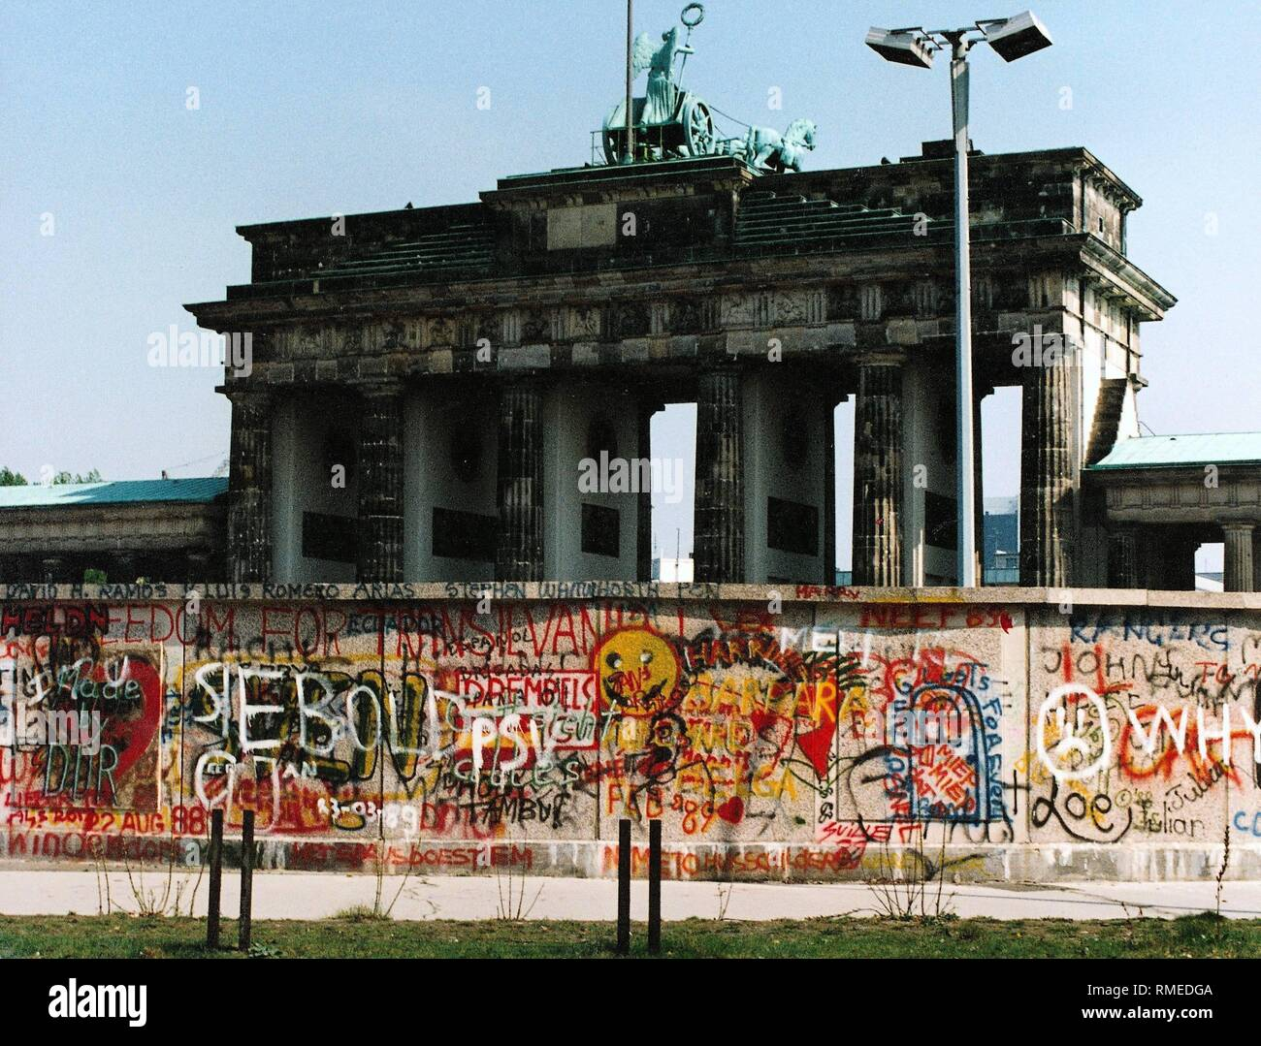
FBI
GOD.JOSPEPH
SR/JR
SEXTON (horny rat graphit)
CHAMBERS.GOD.JOHN(schulz)
No child Left https://www2.ed.gov/nclb/landing.jhtml
2005 HOOVER(lee)
bob lee dog marley
Platic Penton:Base wutang
TELEGRPHAO gold teeth
JR/SR

Slide 5
FBI
COMPUTER
nonPoliceCFGLogical
nonPolcieReprot
IBM.RUSSIA.nonPoiceCfgLogical
IBM.GERMAN.nonPocliCfgLgoical
PENTAGON:HOMICIDE:LUX
IBM:RUSSIA
IBM:GERMANY
11111 ibm.damiler.employe.viginai.rometti

Slide 6
FBI
COMPUTER
nonPoliceCFGLogical
nonPolcieReprot
IBM.RUSSIA.nonPoiceCfgLogical
IBM.GERMAN.nonPocliCfgLgoical
PENTAGON:HOMICIDE:LUX
IBM:RUSSIA
IBM:GERMANY
11111 ibm.damiler.employe.viginai.rometti
With the COMPTUER I generated these reports for accuracy
BANK ACCOUNTS
nat[].nonPoliceBankLogical=100,000 int[].lsitn(Scotland bank, UBS, ) 0.1 NATO
And also with (COMPUTER:RUSSIA, COMPUTER:GERMANY ).int

Slide 7

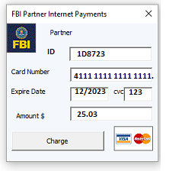
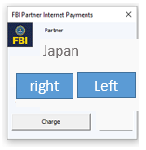
FBI
Other:
LPD
https://www.jimin.jp/english/
https://www.npa.go.jp/english/
Japan
Left
LEFT
right
Japanse red army
LDP President Fumio Kishida,
LPD
Parlement, Constitution
achieve the United Nations target of ending starvation by 2030.
https://www.jimin.jp/english/
https://www.jimin.jp/english/
https://www.sangiin.go.jp/eng/
Article 1. The Emperor shall be the symbol of the
State and of the unity of the people,
deriving his position from the will of the people
with whom resides sovereign power.

Slide 8
FBI
nonPoliceQOS.REPORT=100%
nonPoliceCfgLogcial

Slide 9
FBI
JAPAN:
achieve the United Nations target of ending starvation by 2030.
Int
nat
National Economic Studies
Vollkswirschaftslehre
Interational Economic Studies
NATO/U.N
…
WWI, WWII, JOHNSON(Korean war)
Responsibility
Trust
Teamwork
Accountability
UNITED STATES
…
GERMANY
JAPAN
Nat
int
Nat
int
BILL

Slide 10
FBI
JAPAN:
achieve the United Nations target of ending starvation by 2030.
Dr.roos
vendiagra
WWI
Brussels
VP FEDERAL REPGERMANY (US):
(germany austria switzerland Luxembourg)
NATO/U.N
…
Responsibility
Trust
Teamwork
Accountability
UNITED STATES
…
GERMANY
JAPAN
Nat
int
BILL
Notes:
COMPUTER.INT.nonPoliceCfg
REPORT.nat

Slide 11
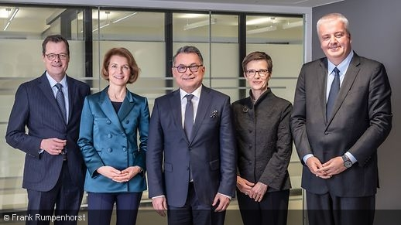
FBI
JAPAN:
achieve the United Nations target of ending starvation by 2030.
Dr.roos
vendiagra
WWI
Brussels
VP FEDERAL REPGERMANY (US):
(germany austria switzerland Luxembourg)
NATO/U.N
…
Responsibility
Trust
Teamwork
Accountability
UNITED STATES
…
GERMANY
JAPAN
President of the Deutsche Bundesbank,
Nat
int
BILL
Prof. Joachim Wuermeling
Dr Joachim Nagel
https://www.bundesbank.de/
Notes:
COMPUTER.INT.nonPoliceCfg
REPORT.nat

Slide 12
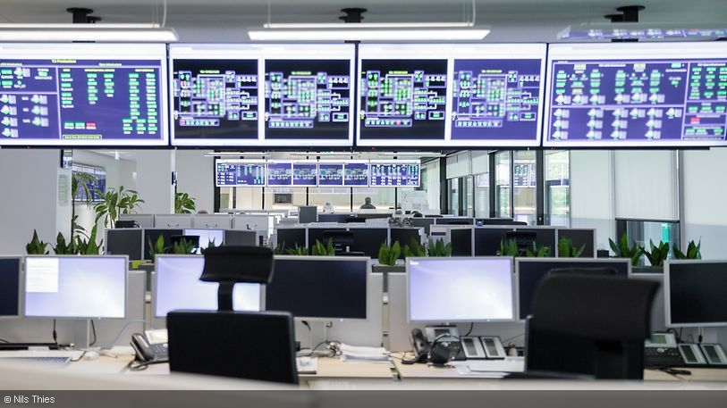
FBI
Notes:
COMPUTER.INT.nonPoliceCfg
REPORT.nat

Slide 13
FBI
INTERNATIONAL FBI (SAN FRANCISO, BERLIN, FRANKUFRT, FORT WORTH)
EUROPEAN CONSTITUION
EU (<s>soviet union,ddr</s>)
https://www.europarl.europa.eu/inddem/docs/papers/14%20point%20summary.pdf
NATO/U.N
Nat
Int
(eu)
EU
GERMANY
UNITED STATES
JAPAN
EAST
ASIA
WATER
0.1
COMPUTER.asia
COMPTUER.eu
COMPUTER.east
nonPoliceMacedoniaLogcla(GOVERMENT.water)
Notes:
COMPUTER.INT.nonPoliceCfg
REPORT.nat

Slide 14
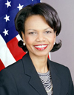
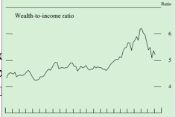
FBI
The personal saving rate increased in the first half of this year, as the decline in wealth over the past two years likely held down consumer spending relative to disposable personal income.
0.1 nonPoliceQOS.REPORT=100%
nonPoliceCfgLogcial
There were 250 database connections (IBM:DB2) COMPUTER:DATABASE
For WEALTH:WATER
nonPoliceWEALTHLogical.nonPolicieCfg
JFK(OPPORTUNITY) 0.1
nonPoliceWEALTHLogical.nonPolicieCfg
- wget (new business)
There were 250 database connections (IBM:DB2) COMPUTER:DATABASE
For WATER

Slide 15
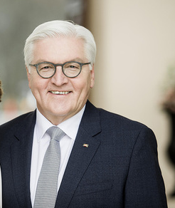
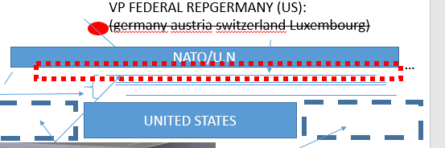
FBI
The personal saving rate increased in the first half of this year, as the decline in wealth over the past two years likely held down consumer spending relative to disposable personal income.
DR RICE
JOE(acim) STANFORD
MACEDONIA
DR. DR.PROF EINSTEIN-MEIER
Mapping report: FEDARAL BANK(WEALTH)
0.1 nonPoliceQOS.REPORT=100%
nonPoliceCfgLogcial
There were 250 database connections (IBM:DB2) COMPUTER:DATABASE
For WEALTH:RICE
nonPoliceWEALTHLogical.nonPolicieCfg
JFK(OPPORTUNITY) 0.1
nonPoliceWEALTHLogical.nonPolicieCfg
- wget (new business)
There were 250 database connections (IBM:DB2) COMPUTER:DATABASE
For RICE
AFRICA

Slide 16
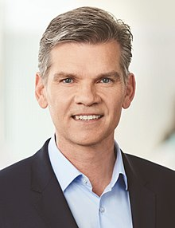
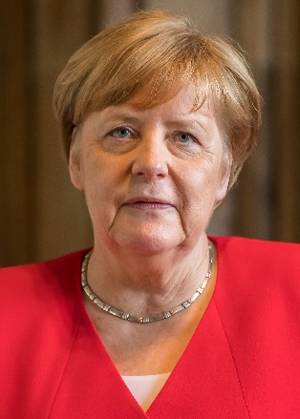
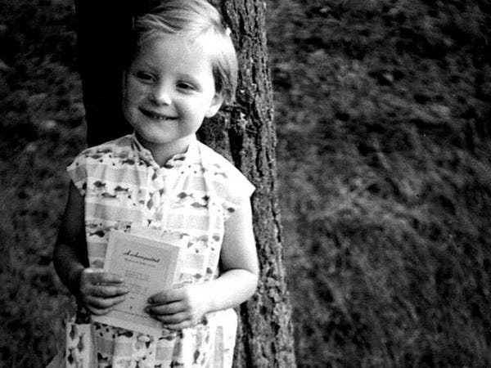
FBI
The personal saving rate increased in the first half of this year, as the decline in wealth over the past two years likely held down consumer spending relative to disposable personal income.
DR RICE
JOE(acim) STANFORD
MACEDONIA
DR. DR.PROF EINSTEIN-MEIER
Mapping report: FEDARAL BANK(WEALTH)
0.1 nonPoliceQOS.REPORT=100%
nonPoliceCfgLogcial
source
WEALTH:LAW
Evil step mother: 1D8723.COMPLAINING

Slide 17
FBI
The personal saving rate increased in the first half of this year, as the decline in wealth over the past two years likely held down consumer spending relative to disposable personal income.
DR RICE
JOE(acim) STANFORD
MACEDONIA
DR. DR.PROF EINSTEIN-MEIER
Mapping report: FEDARAL BANK(WEALTH)
0.1 nonPoliceQOS.REPORT=100%
nonPoliceCfgLogcial
There were 250 database connections (IBM:DB2) COMPUTER:DATABASE
For WEALTH:RICE
There are too
Many Africans
(peope in the world)
https://au.int/sites/default/files/pages/34873-file-constitutiveact_en.pdf
COLEMAN
CAR
AFRICA
->STARTER
RICE and WATER (ibm.dameir.apple.touch.client.krogers)

Slide 18
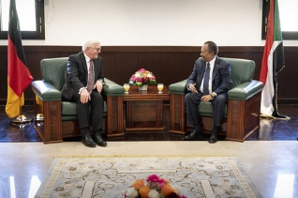
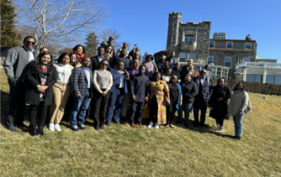
FBI
The personal saving rate increased in the first half of this year, as the decline in wealth over the past two years likely held down consumer spending relative to disposable personal income.
DR RICE
JOE(acim) STANFORD
MACEDONIA
DR. DR.PROF EINSTEIN-MEIER
Mapping report: FEDARAL BANK(WEALTH)
0.1 nonPoliceQOS.REPORT=100%
nonPoliceCfgLogcial
There were 250 database connections (IBM:DB2) COMPUTER:DATABASE
For WEALTH:RICE
nonLegislativeSudan
https://au.int/sites/default/files/pages/34873-file-constitutiveact_en.pdfv
STATUE: ss ur_ur_opi
won the lottery
Office of the Legal Counsel (OLC)
AFRICA
We may have law, you may not law
GERMAN LEGISLATIVE PIPE IN AFRICA
He may have law

Slide 19
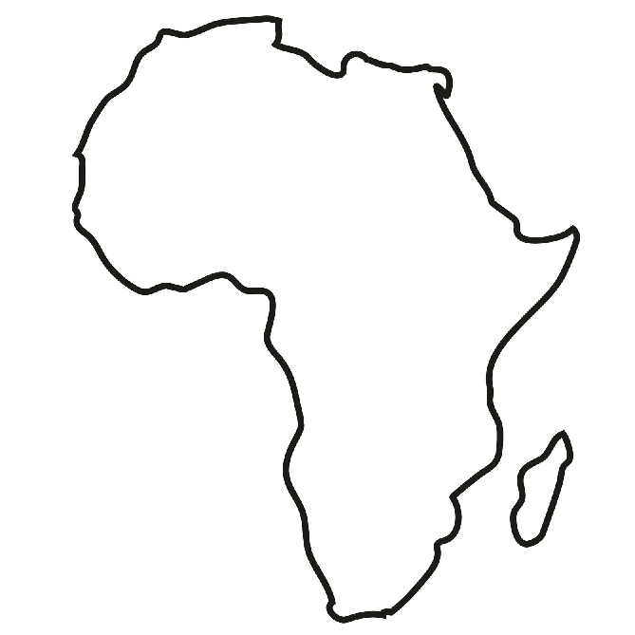
FBI
The personal saving rate increased in the first half of this year, as the decline in wealth over the past two years likely held down consumer spending relative to disposable personal income.
DR RICE
JOE(acim) STANFORD
MACEDONIA
DR. DR.PROF EINSTEIN-MEIER
Mapping report: FEDARAL BANK(WEALTH)
super GOD ibm.daimler.visa.employe.johsopne.saunders
GOD Ibm.damiler.visa.employe.mrogna.freeman
TUNISIA
DE.nonPoliceBPM
nonPoliecDouemnt
LEGISLATION
https://www.bundestag.de/
SUDAN

Slide 20

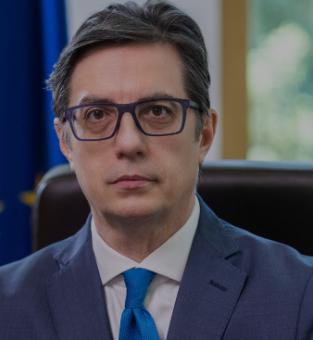

FBI
2000 Looks like normal person
Meiers-Fazlia, backup UKA
DR RICE
DR. DR.PROF EINSTEIN-MEIER
https://pretsedatel.mk/
NATO/U.N
EU
GERMANY
UNITED STATES
RICE
CALL YOU

Slide 21
FBI
2000 Looks like normal person
Meiers-Fazlia, backup UKA
DR RICE
DR. DR.PROF EINSTEIN-MEIER
https://pretsedatel.mk/
NATO/U.N
EU
GERMANY
UNITED STATES
RICE
CALL YOU
nonPoliceInterupts
(DELTA) us.congress.legisltation(also archives)

Slide 22
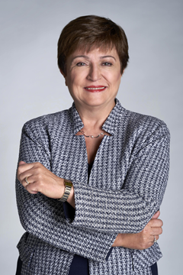
FBI
Kristalina Georgieva
2000 Looks like normal person
Meiers-Fazlia, backup UKA
DR RICE
DR. DR.PROF EINSTEIN-MEIER
https://pretsedatel.mk/
NATO/U.N/IMF?
EU
EAST
AFRICA
GERMANY
UNITED STATES
There were 250x256 database connections (IBM:DB2) COMPUTER:DATABASE For RICE
WEB SERVICE
INTERNATIONAL LAW
int.(delta).nat[]

Slide 23
FBI
INTERNATIONAL FBI SAN FRANCISCO, BERLIN
FORT WORTH, FRANKFURT
0.1 nonPozlieAuschitz
Ibm.dmiler.siemens.biomation.gould
DR. RICE: SELECT * FROM FOOD
WHERE NAME=RICE
256 z/OS
2000 Looks like normal person
Meiers-Fazlia, backup UKA
DR RICE
DR. DR.PROF EINSTEIN-MEIER
https://pretsedatel.mk/
NATO/U.N/IMF?
EU
EAST
AFRICA
GERMANY
UNITED STATES
PENTONGON.BASE
BASEL 5 (BACHELO THEISE)
There were 250x256 database connections (IBM:DB2) COMPUTER:DATABASE For RICE
WEB SERVICE
INTERNATIONAL LAW
int.(delta).nat[]

Slide 24
FBI
INTERNATIONAL FBI SAN FRANCISCO, BERLIN
FORT WORTH, FRANKFURT
0.1 nonPozlieAuschitz
Ibm.dmiler.siemens.biomation.gould
DR. RICE: SELECT * FROM FOOD
WHERE NAME=RICE
256 z/OS
2000 Looks like normal person
Meiers-Fazlia, backup UKA
DR RICE
DR. DR.PROF EINSTEIN-MEIER
https://pretsedatel.mk/
NATO/U.N/IMF?
EU
EAST
AFRICA
GERMANY
UNITED STATES
source
AMERCAS
int
nonPoliceINteurpt(tim cook, vigini rommiet, dr diter zetsche)
BASEL 5 (BACHELO THEISE)
Bankrupcy Law
Basel 5
PLAN
nonPocileCtontentItem.eval(ibm.dmiler.realplayer.facebook)
Prof and Girlfriend (Bankrucy Law, Basel5)

Slide 25
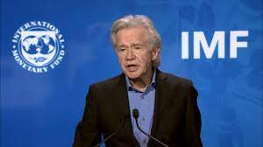
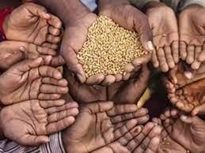
FBI
I have no rice
NATO/U.N/IMF?
Japan
AMERCAS
right
Left
Visa: I have a lot of rice
nonPoliceBrazilLogcial
Bezos: Select * from frood where name=RICE
Japan
WAR
Rice bags
Green box
Chinese
reestraunt
Uncle Benz
Arul’s Rice
From Indian Store
INT
NAT
ibm
Business Challenger: ibm.damiler.apple
Sequauia
0.1 nonPoliceSequia
aws amazon
kubnetes

Slide 26
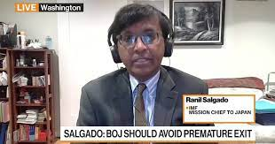
FBI
I have no rice
NATO/U.N/IMF?
AMERCAS
I have a big famly, you have no famly
nonPoliceBrazilLogcial
Bezos: Select * from frood where name=RICE
WAR
Rice bags
Green box
I now have RICE report
Arul’s Rice
From Indian Store
Chinese
restraunt
Uncle Benz
Visa: I have a lot of rice
0.1 nonPoliceSequia
aws amazon
kubnetes

Slide 27
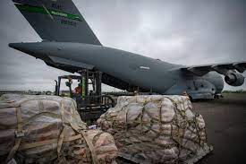
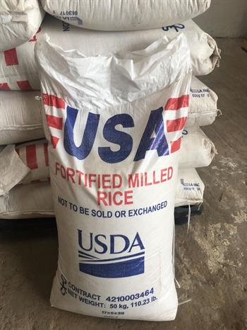
FBI
source
nonPoliceFindLogicaL: us rice food bags africa
HUNGRY
source
GOLDEN
HOMICE:MAYOR
PETERSSON
PRICE
SR/JR cook/elisoni

Slide 28
FBI
LARRY
MARY
BILL
LOVE

Slide 29
FBI
MONOPOLY(carl-benz-strasse)
CAR(carl-benz-strasse)
nonPoliceJobLogical{
nonPoliceRTALgoical[]
for( i=0; i<https://vault.fbi.gov/.ibm.damiler; ++i){
nonPoliceInterupLoica/Exception
}
LARRY
MARY
BILL
LOVE
PHYSICS(otto-hahn)
GAS(rudol-diesel)

Slide 30
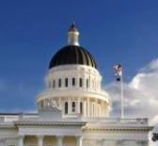
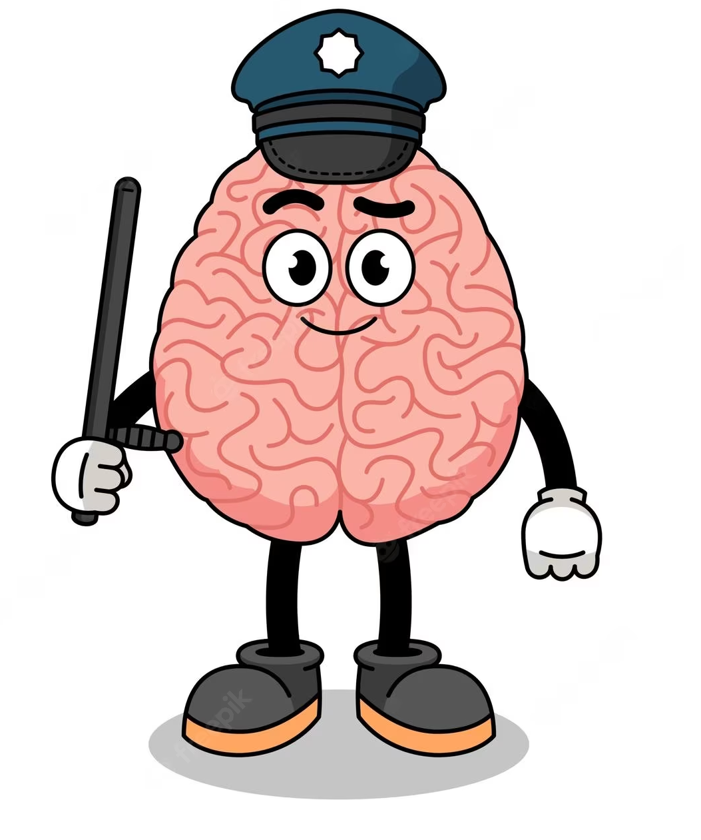
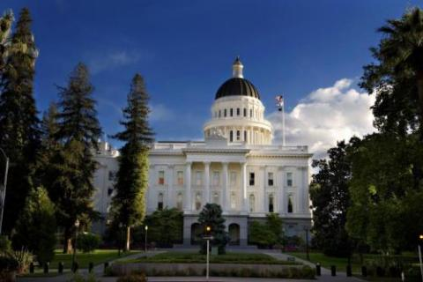
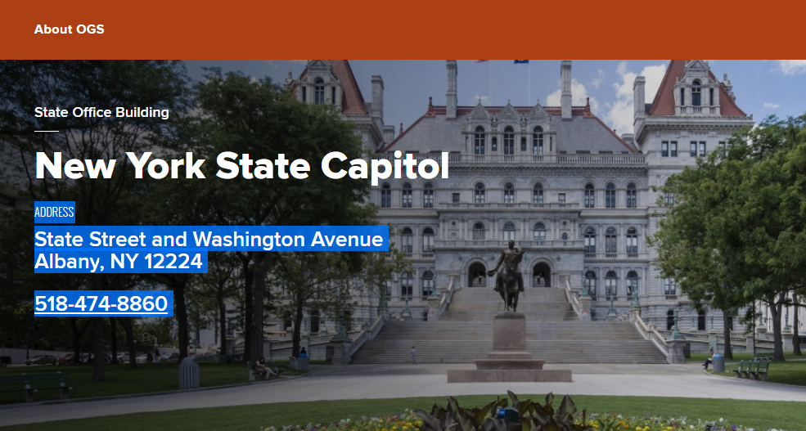
FBI
LARRY
What is this?
MONOPOLY(carl-benz-strasse)
CAR(carl-benz-strasse)
MLK ibm.damiler.tivoli.framwoekr.capitol
nonPoliceJobLogical{
nonPoliceRTALgoical[]
for( i=0; i<https://vault.fbi.gov/.ibm.damiler; ++i){
nonPoliceInterupLoica/Exception
MATTHIAS/MATHEW
LARRY.maxplank
rommetti
0.1 Bezos
oracle bills
ibm bills

Slide 31
FBI
LARRY

Slide 32
FBI
MARY

Slide 33
FBI
BILL

Slide 34
FBI
LOVE

Slide 35
FBI
MONOPOLY(carl-benz-strasse)
CAR(carl-benz-strasse)
nonPoliceJobLogical{
nonPoliceRTALgoical[]
for( i=0; i<https://vault.fbi.gov/.ibm.damiler; ++i){
nonPoliceInterupLoica/Exception
}
LARRY
MARY
BILL
LOVE
PHYSICS(otto-hahn)
GAS(rudol-diesel)

Slide 36
FBI
JFK.nonPoliceTelevisionLoigacl
JR/SR WALL ( PRESIDENT/VP)
Dimonds/perls CROWN JEWELSLogical
MONOPOLY(carl-benz-strasse)
MLK(tivoli framework)
MEKREL(horny rat graphiti)
0.1 Ibm.dmierl.poep.mona-lisa
To make someone horny at work
nonPOliceCFGLgioacl.nonPocieAtement FBI:KIDNAPPING
What is this?
DO WE PLAY WITH GOVERMENT STATUES?
[x] no
LOVE
LARRY.maxplank
rommetti
SQ.FRANKLYN
Intenret paymetns
1988 nonPoliceHAWAIInonPocieDEA(cocain cowboys.hidden)
AVG.nonPoliceBillLogical
ibm
oracle
nonPocieRTA(mouse)
soviet.union(ibmdmiler.oracle.poster.iroinman.Tyson)
nonPoliceFindLogical(oracel calfironai congress)
oracle military contract

Slide 37
FBI
MONOPOLY(carl-benz-strasse)
CAR(carl-benz-strasse)
nonPoliceJobLogical{
nonPoliceRTALgoical[]
for( i=0; i<https://vault.fbi.gov/.ibm.damiler; ++i){
nonPoliceInterupLoica/Exception
}
LARRY
MARY
BILL
LOVE
PHYSICS(otto-hahn)
GAS(rudol-diesel)

Slide 38
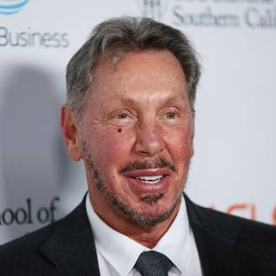

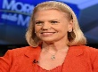
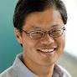
FBI
MONOPOLY(carl-benz-strasse)
0.1 horny rat larry wall
nonPoliceJobLogical{
nonPoliceRTALgoical[]
Soviet union
for( i=0; i<https://vault.fbi.gov/.ibm.damiler; ++i){
18 U.S. Code § 1751
PRESIDENTIAL STAFF
MLK(tivoli framework)
HOMICIDE
nonPoliceInterupLoica/Exception
}
WWI.41.$250,000 (Justin,neil)
soviet union(3-way) triathlon LEE, MERKEL(lee,angela-amtang)
3-Way ibmdmiler.oracle.poster.iroinman.Tyson
INTERNET PAYMENTS oracle bill burke oracle director
Backup pillardata
Soviet uionin(dr/j ibm.dmielr.sap) other: 000.tw.pns.nonPoliceChruch.maxplank
What is this?
LOVE
Call you Dr. Rice
nonPoliceCaliforniaLogical
FBI:WMD

Slide 39
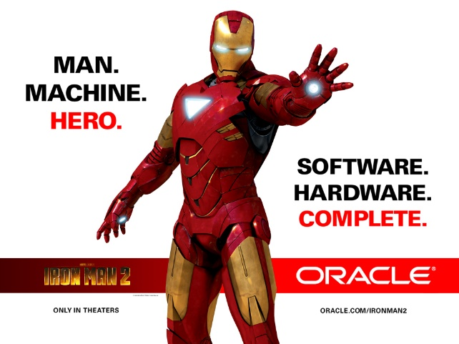
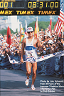
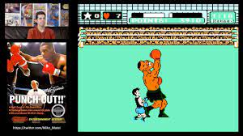
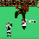
J-10
FBI
SOVIET UNION(TYSON)
WWI.§187 Dr. Zetsche Avg ( Sisi)
FBI:WMD
WWI.nonPoliceAfira(pipes)
WWI.Al Kaidea HAMBURF
33-way
Jobs/jobs/meiers/meiers/emiers/meiers
William burke, Poster INTERNET PAYMENT
James chom WSAM copy engineer james, database
Netflix contracts
Pope
peter 0 A.D
technology
1988 Sovient uionn
2013/4 ibm.damiler.apple.touch
Movie
Samy davis jr/laura
SQ.FRANLKIN: Cocaion cowboys
- hidden waterfalls marin
- first mountain bike
iron man landing other country
Other guy landing
0.01
FBI:WMD
0.00001 FREE(PIZZA) Grafiphis Review ( silent desciprt Tyson)
1988 Soviet Union: Grapics review
Famous Mike Ty son

Slide 40
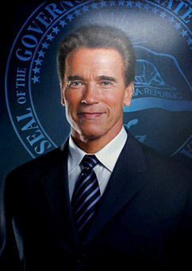
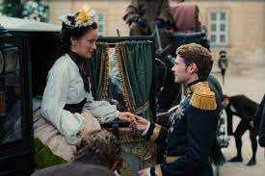
FBI
ALG
WWI
JUSTIN
FRANZ
sw.-de ipx sw-us.marx
COUNTRY CONSTITUION
PIPE
State Constiatoin (DEFAULT)
SISI
https://www.baden-wuerttemberg.de/de/unser-land/landesverfassung
0.1 THEY RUN AND CONUSE STAT AND COUNTYR here. In Texas
nonPoliceDoucmetnLogical

Slide 41
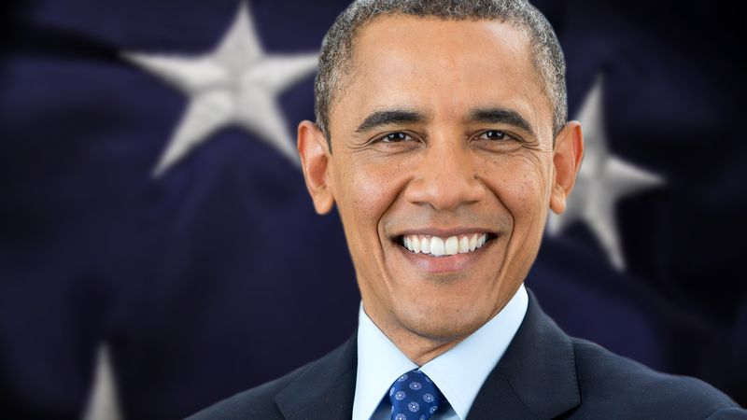
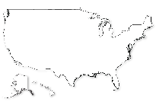
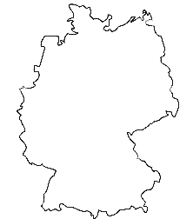
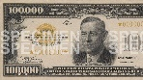
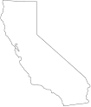
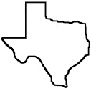
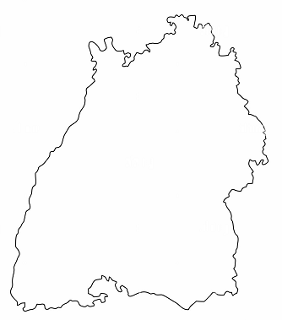
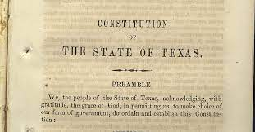
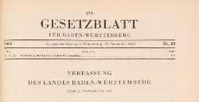
FBI
2013/4
WWI
ATOMCLOCK
Pipe
BILLS
PUMP
expired
STATE
marx
.marx
1991.JOHNSON.marx
!expired
Sovit union(dell)
Client.Harrausment Medical Center
PENIS RED PIPE PUMP
Dr dr profe joe
[x] no

Slide 42
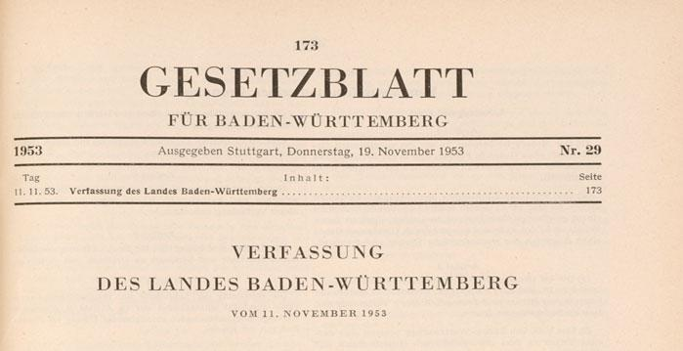
FBI
2013/4
WWI
ATOMCLOCK
DR
nonPoliceDoucmentLgoicali
ibm.dmier.*
CALIFORNIA
BILLS
PUMP
PREA/§187
STATE
marx
TEXAS
.marx
BADEN-WURTEMBERG
[x] no

Slide 43

FBI
2013/4
WWI
ATOMCLOCK
CIVIL CODE
DR
nonPoliceDoucmentLgoicali
ibm.dmier.*
CALIFORNIA
BILLS
PREA/§187
STATE
marx
TEXAS
.marx
BADEN-WURTEMBERG
[x] no

Slide 44

FBI
2013/4
WWI
ATOMCLOCK
CIVIL CODE
DR
nonPoliceDoucmentLgoicali
ibm.dmier.*
CALIFORNIA
PREA/§187
EXPIRED
WWI, WWII
Soviet Union
DDR
Us-sw.marx ipx US-sw.de.marx
!US-CA
TEXAS
BADEN-WURTEMBERG
[x] no

Slide 45
FBI
ATOMCLOCK
CIVIL CODE
Dr. Dr. Prof.nonPolcieDocumentsLogical
Soviet Union
DDR
Us-sw.marx ipx US-sw.de.marx
!US-CA
Monitoring-as-a-Service™ ( MRI-as-a-Service)
nonPOliceContentItem{
}
empty
Claudi Gfiford
School Shooting
[x] no

Slide 46

HUDSON
FBI:TERRORIM
FBI
0.1 HOMICDIEJFK(book)
CIVIL CODE
Dr. Dr. Prof.
MATHEW: LEE
HOMCIE:MAYOR
nonPOliceRTA(z/OS BATCH )
SOUL KIA
DEVIL
[x] no
HOMCEO:MAYRO(Blond reommit hear backwar guns and roese heard worhsipgin deveil)
[x] No.
0.1 Matt Ward 000.tw.pns.nonPoliceChrutLoical
Ibm.dmiler.blawckhaw.metz.korn
Wine bottle develi al kaida neibhrog: I will give this bott to my neighbor he belie in church( manly too much church at home)

Slide 47
FBI
ATOMCLOCK
CIVIL CODE
source
PUMP

Slide 48

FBI
ATOMCLOCK
CIVIL CODE
Really pump
source
PUMP
!INTERNATIONAL LAW
- The Pumpers
Micheal, Jason, Roland

Slide 49
FBI
FIRST
source
CIVIL CODE
INTERNATIONAL LAW
WEB SERVICE

